Slide 1
Final Project
STUDENT NAME:ABINESH.A
DEPARTMENT :ARTIFICIAL INTELLIGENCE AND DATA SCIENCE
COLLEGE :SIR ISSAC NEWTON COLLEGE OF ENGINEERING AND TECHNOLOGY
NAAN MUDHALVAN I’D: au821721243002

Slide 2
PROJECT TITLE
SMS SPAM DETECTION

Slide 3


AGENDA
PROBLEMSTATEMENT
PROJECT OVERVIEW
WHO ARE THE END USERS?
YOUR SOLUTION AND ITS VALUE PROPOSITION
THE WOW IN YOUR SOLUTION
MODELLING
RESULTS
3/21/2024 Annual Review

Slide 4

PROBLEM STATEMENT
Problem Statement: Short Message Service (SMS) is a widely used communication service where messages are sent electronically. The decreasing cost of SMS services by telecom companies has led to an increased utilization of SMS
Spam messages inundate users’ inboxes, making it challenging to distinguish legitimate messages from spam. In this context, developing an effective SMS spam detection model becomes crucial. We’ll explore how to create such a model using Naive Bayes and Natural Language Processing (NLP) techniques.
To tackle this problem, we’ll work with the Kaggle SMS Spam Collection Dataset, which contains a set of SMS-tagged messages in English. Each message is classified as either “ham” (legitimate) or “spam”. The dataset includes two columns:
v1: Carries the label (spam or ham).
v2: Contains the actual content of the SMS.

Slide 5

PROJECT OVERVIEW
Dataset Exploration:
We’ll start by loading the Kaggle SMS Spam Collection Dataset
Dataset Exploration:
We’ll start by loading the Kaggle SMS Spam Collection Dataset
Feature Extraction:
Represent the text data numerically:
Use techniques like TF-IDF (Term Frequency-Inverse Document Frequency) or word embeddings.
Model Selection and Training:
Split the data into training and testing sets.
Train the model on the training data

Slide 6

WHO ARE THE END USERS?
The end users of the SMS spam detection system are individuals who receive SMS messages on their mobile phones. These users want to distinguish between legitimate messages (such as personal communication, notifications, or important alerts) and unwanted spam messages. By deploying an effective spam detection model, we aim to enhance the user experience by filtering out spam and ensuring that users only receive relevant and meaningful SMS content

Slide 7
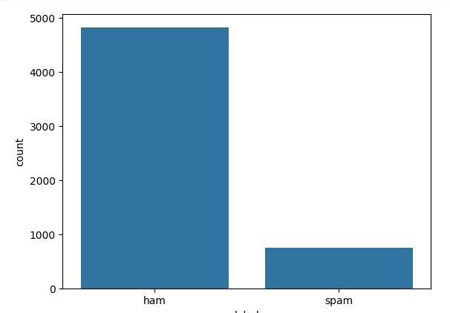
YOUR SOLUTION AND ITS VALUE PROPOSITION

Slide 8

THE WOW IN YOUR SOLUTION
Slide 1: Introduction
Welcome to our presentation on "The WOW in Your Solution"!
Slide 2: What is "The WOW"?
It's that special ingredient that sets your solution apart from the rest.
Slide 3: Why it Matters
"The WOW" creates unforgettable experiences for your customer.
Slide 4: Features of "The WOW"
Cutting-edge technolog
Slide 5: Benefits for Your Business
Increased customer satisfaction

Slide 9
MODELLING
Spam-Classifier: A natural language processing project that predicts whether an SMS is spam or ham using various ML algorithms like multinomial Naïve Bayes, logistic regression, SVM, and decision trees.
SPAM-SMS-Prediction: An SMS spam prediction project using NLP and machine learning.
Research Papers:
A Proposal of Systematic SMS Spam Detection Model Using Supervised Machine Learning Classifiers: This paper explores systematic models for detecting SMS spam using machine learning classifiers.
ensorFlow Implementation:
SMS Spam Detection using TensorFlow in Python: This article demonstrates deep learning models (Dense Network, LSTM, and Bi-LSTM) for SMS spam detection using TensorFlow

Slide 10
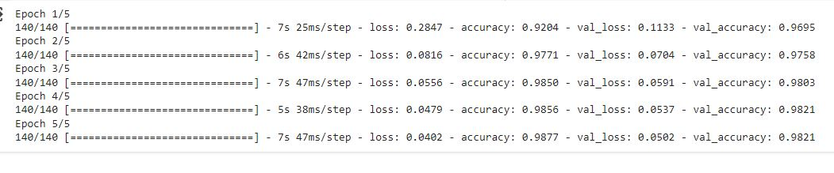
RESULTS
Epoch 1/5:
Training Loss: 0.2847
Training Accuracy: 0.9204
Validation Loss: 0.1133
Validation Accuracy: 0.9695
Epoch 2/5:
Training Loss: 0.0816
Training Accuracy: 0.9771
Validation Loss: 0.0704
Validation Accuracy: 0.9758
Epoch 3/5:
Training Loss: 0.0656
Training Accuracy: 0.9858
Validation Loss: 0.0591
Validation Accuracy: 0.9883

